Slide 1
Improve VAE with Optimal Transfer
学号：19210240019
Reporter: 庞泽雄

Slide 2
Paper List
Wasserstein Autoencoder
Ilya Tolstikhin, Olivier Bousquet, Sylvain Gelly, and Bernhard Sch¨olkopf
NIPS 2018
Adversarially Regularzie Autoencoder
Jake (Junbo) Zhao Yoon Kim Kelly Zhang Alexander M. Rush Yann LeCun
ICML 2018

Slide 3
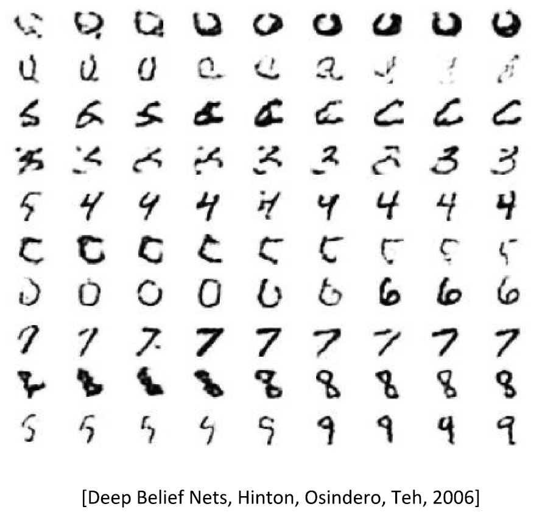
Unsupervised Generation

Slide 4
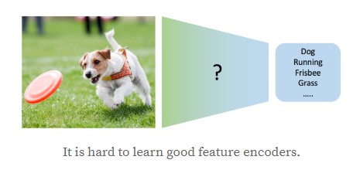
VAE

Slide 5
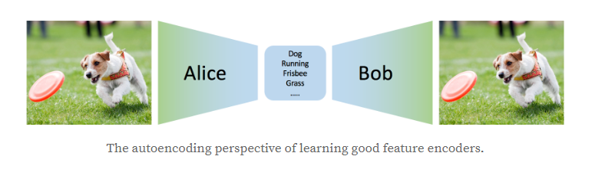
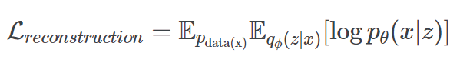
VAE

Slide 6
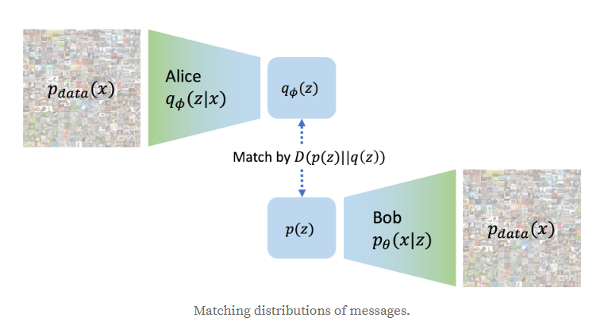
VAE

Slide 7
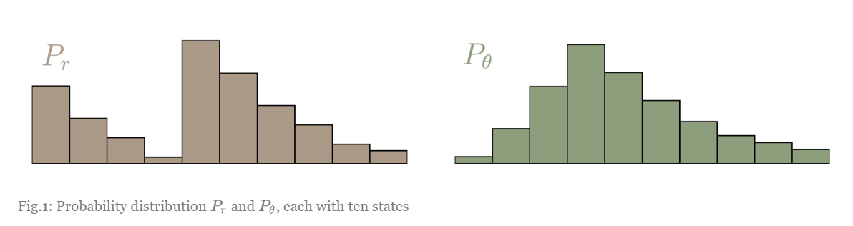
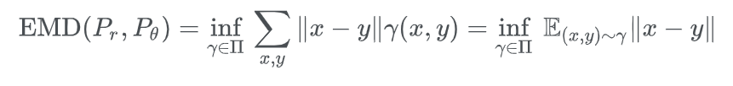
Wasserstein Distance
Earth Move Distance

Slide 8
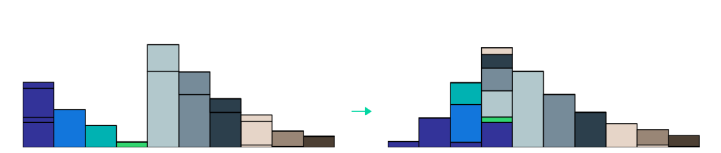
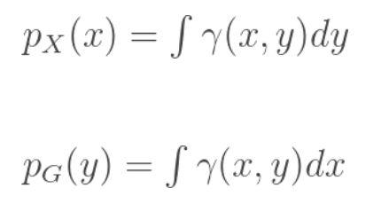
Wasserstein Distance

Slide 9
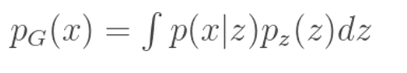
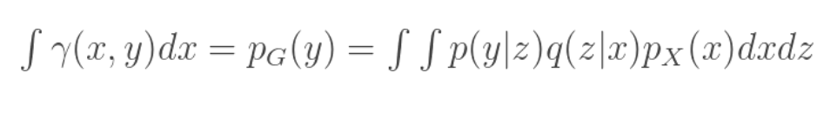
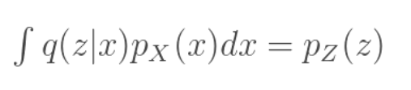
WAE — Inference
Constraint:

Slide 10
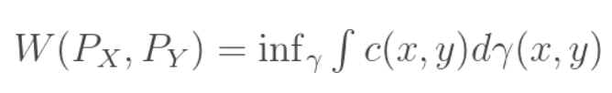
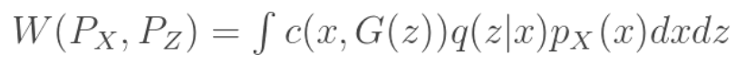
WAE – Inference

Slide 11
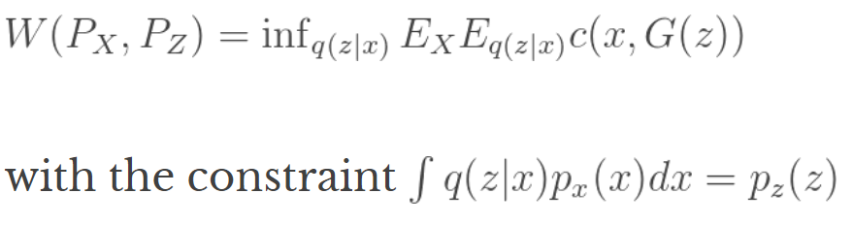
WAE – Inference

Slide 12
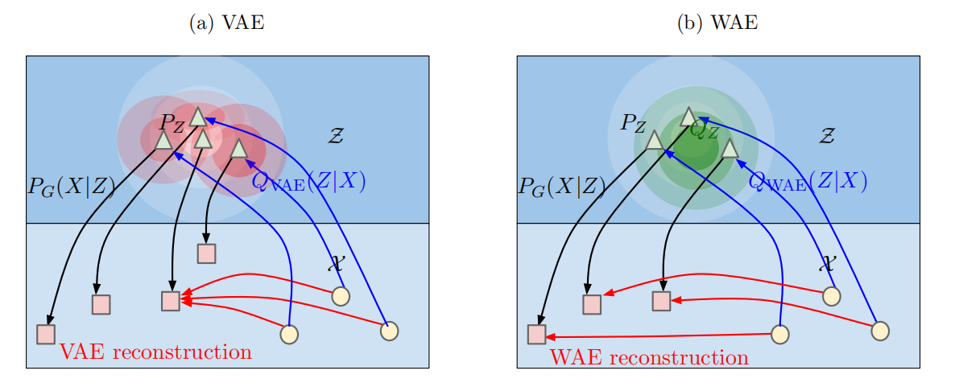
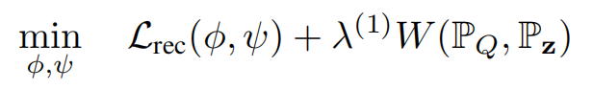
WAE

Slide 13
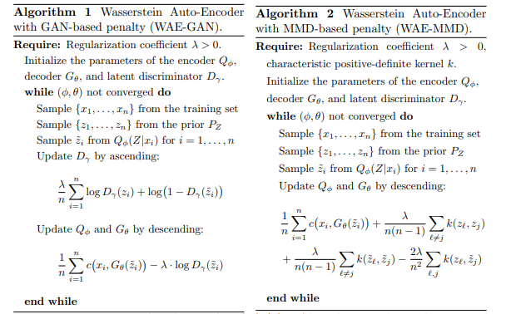
WAE – Algorithm

Slide 14
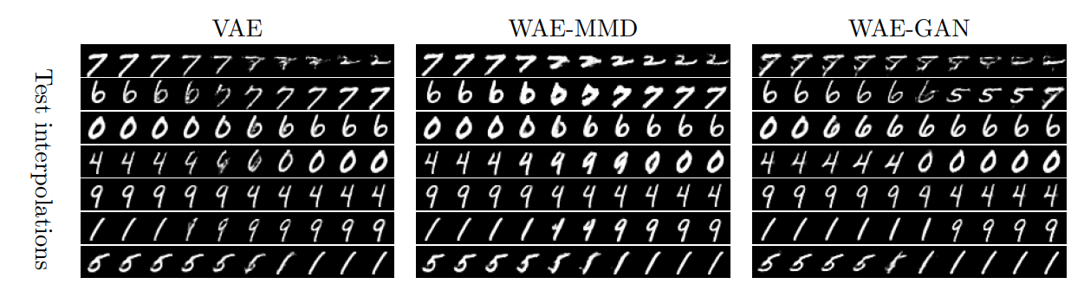
WAE — Mnist test

Slide 15
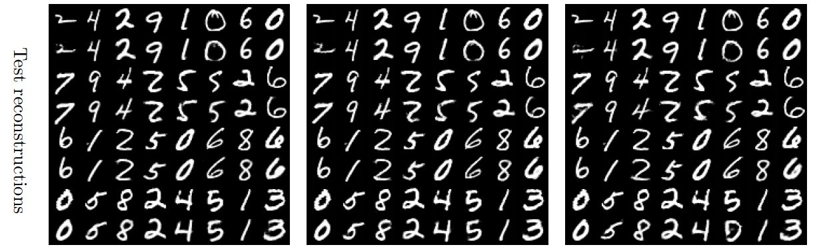
WAE—Mnist test

Slide 16
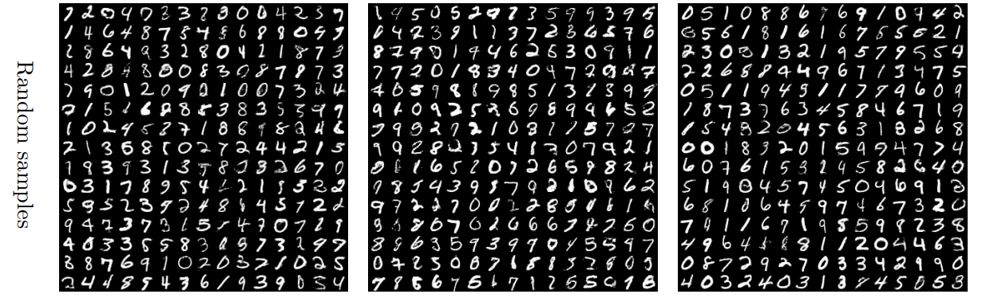
WAE — Mnist test

Slide 17
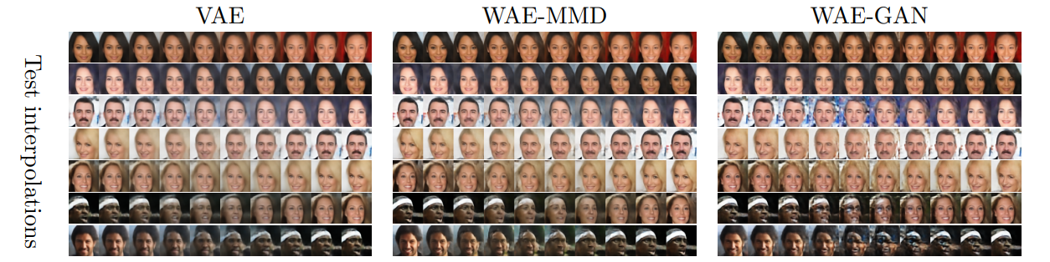
WAE – CelebA

Slide 18
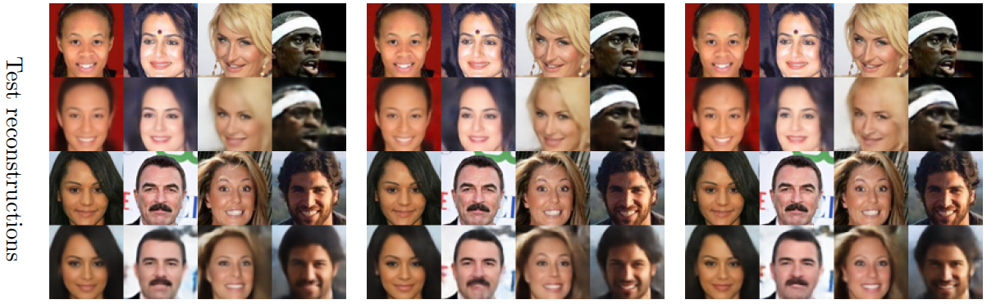
WAE – CelebA

Slide 19
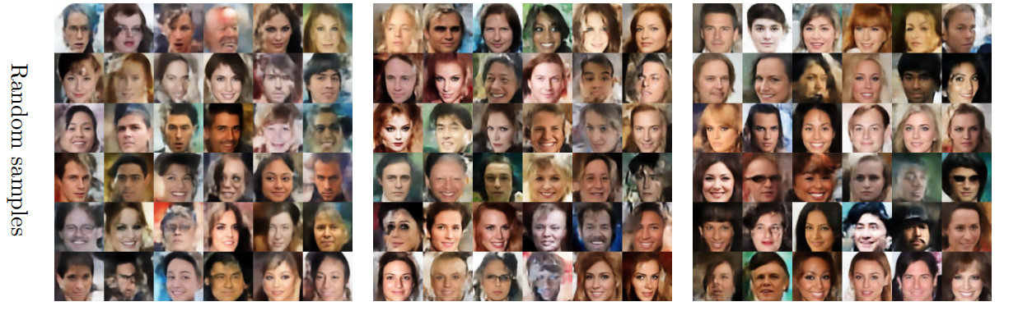
WAE – CelebA

Slide 20
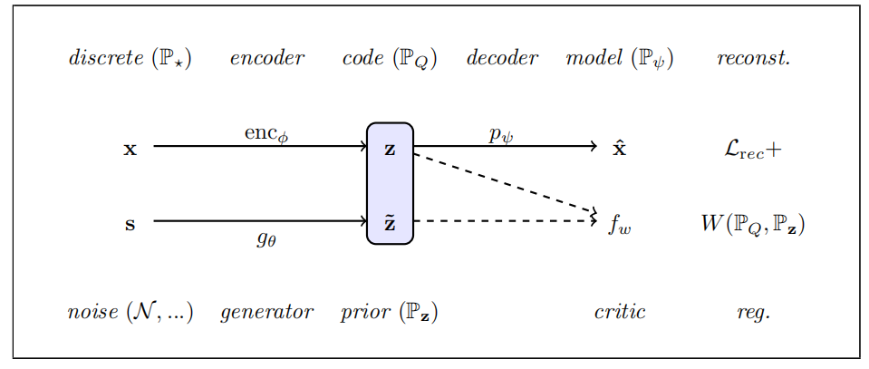
ARAE – Architecture

Slide 21
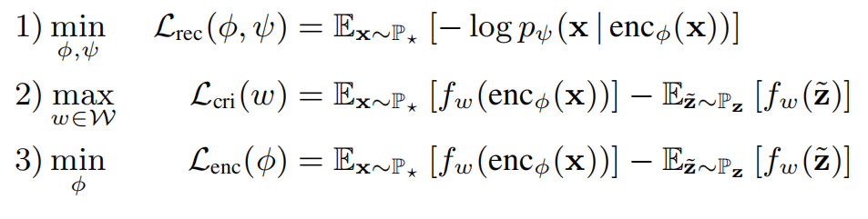
ARAE – Inference

Slide 22
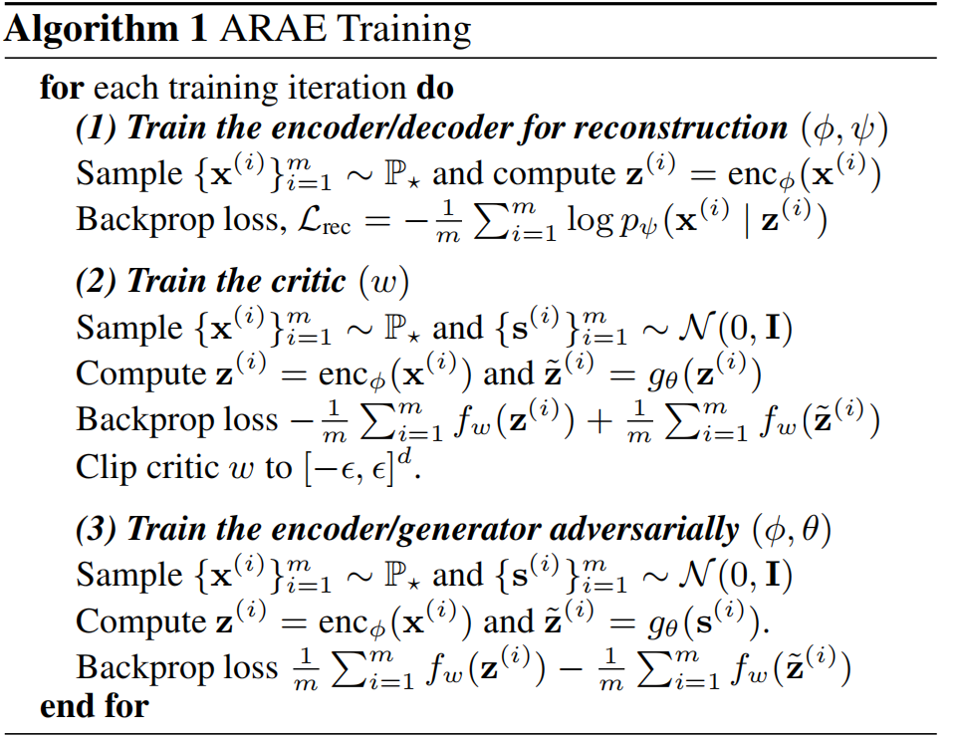
ARAE

Slide 23
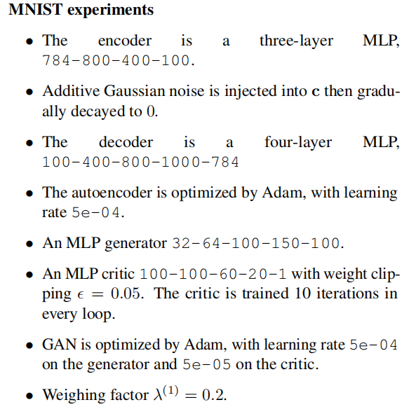
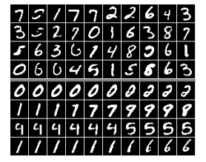
ARAE – Mnist

Slide 24
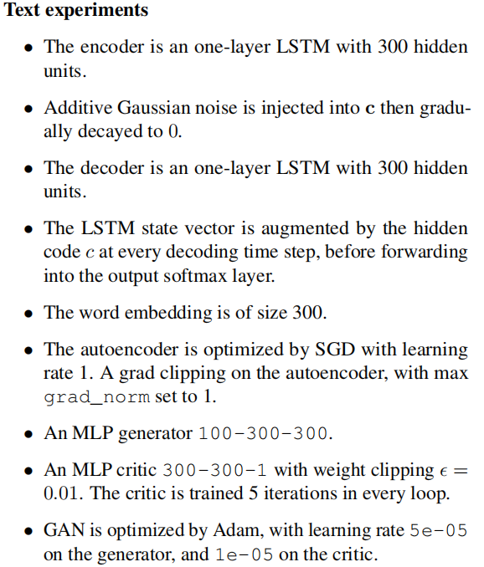
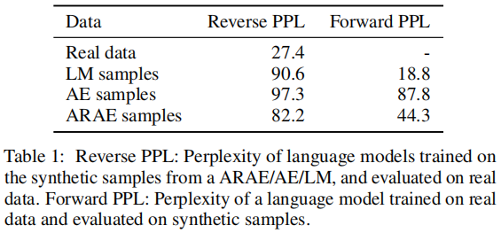
Language Model Results

Slide 25
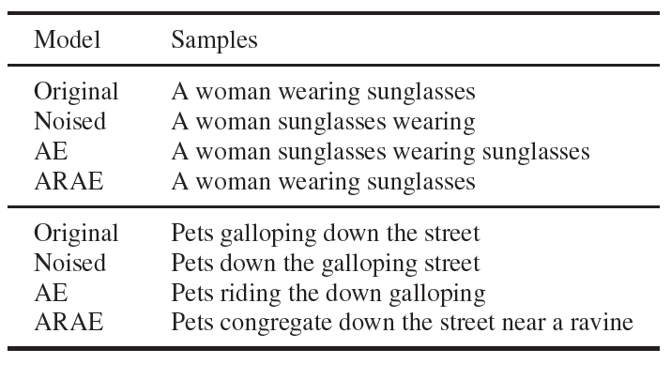
ARAE – Reconstruction

Slide 26
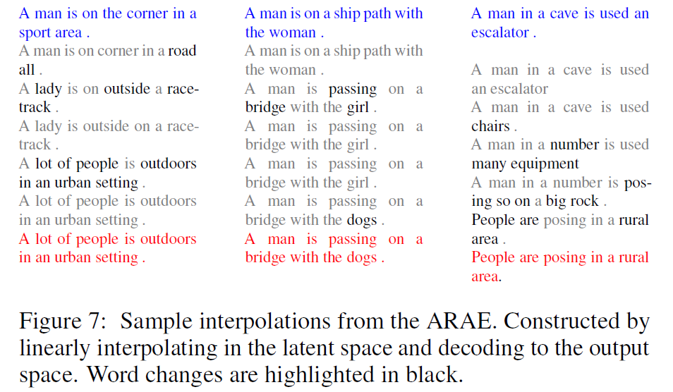
ARAE – Interpolation

Slide 27
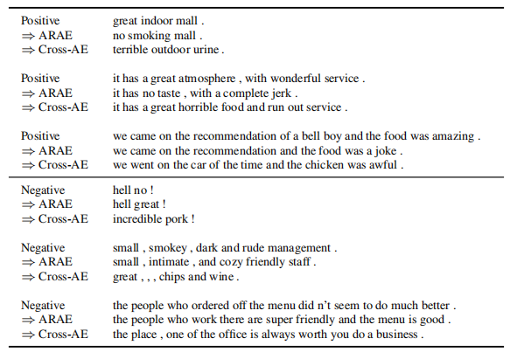
ARAE — Sentiment Transfer

Slide 28
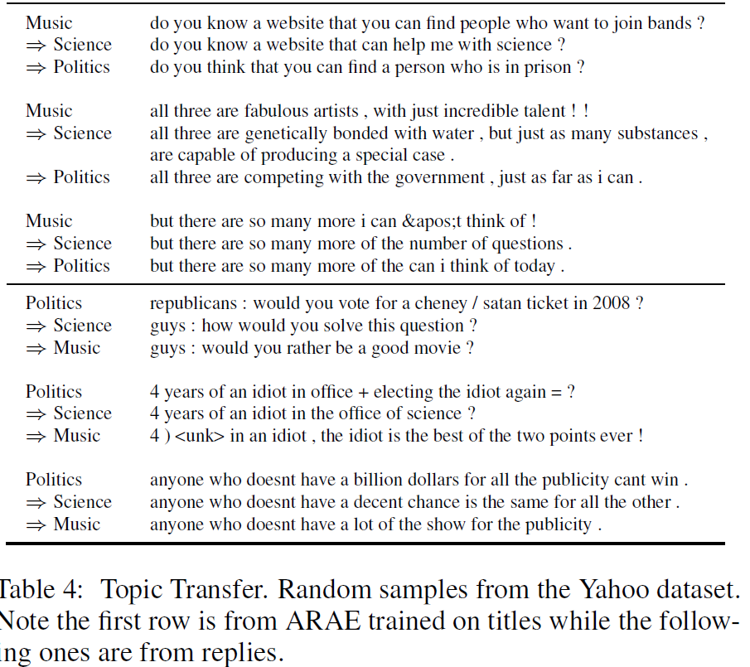
ARAE — Topic Transfer

Slide 29
Conclusion
Key contribution:
Cast the Wasserstein distance metric to setup the VAE/GAN problem
A cookbook of VAE and GAN
Fit CV and NLP generation tasks

Slide 30
Thank you!

